Slide 1
Highlights of Spring ’15
Marc Baizman
Customer Success Director
Salesforce.com Foundation
@mbaizman

Slide 2
Safe Harbor Statement
Safe harbor statement under the Private Securities Litigation Reform Act of 1995:
This presentation may contain forward-looking statements that involve risks, uncertainties, and assumptions. If any such uncertainties materialize or if any of the assumptions proves incorrect, the results of salesforce.com, inc. could differ materially from the results expressed or implied by the forward-looking statements we make. All statements other than statements of historical fact could be deemed forward-looking, including any projections of product or service availability, subscriber growth, earnings, revenues, or other financial items and any statements regarding strategies or plans of management for future operations, statements of belief, any statements concerning new, planned, or upgraded services or technology developments and customer contracts or use of our services.
The risks and uncertainties referred to above include – but are not limited to – risks associated with developing and delivering new functionality for our service, new products and services, our new business model, our past operating losses, possible fluctuations in our operating results and rate of growth, interruptions or delays in our Web hosting, breach of our security measures, the outcome of any litigation, risks associated with completed and any possible mergers and acquisitions, the immature market in which we operate, our relatively limited operating history, our ability to expand, retain, and motivate our employees and manage our growth, new releases of our service and successful customer deployment, our limited history reselling non-salesforce.com products, and utilization and selling to larger enterprise customers. Further information on potential factors that could affect the financial results of salesforce.com, inc. is included in our annual report on Form 10-K for the most recent fiscal year and in our quarterly report on Form 10-Q for the most recent fiscal quarter. These documents and others containing important disclosures are available on the SEC Filings section of the Investor Information section of our Web site.
Any unreleased services or features referenced in this or other presentations, press releases or public statements are not currently available and may not be delivered on time or at all. Customers who purchase our services should make the purchase decisions based upon features that are currently available. Salesforce.com, inc. assumes no obligation and does not intend to update these forward-looking statements.

Slide 3
Thank you.
THANK Y U

Slide 4
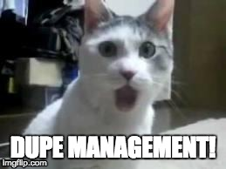
I PICKED THE “OMG” FEATURES

Slide 5
www.salesforce.com/customer-resources/releases/spring15/
http://releasenotes.docs.salesforce.com/en-us/spring15/release-notes/salesforce_release_notes.htm
“The Official Release Notes”

Slide 6
Agenda
When are you getting Spring ‘15?
Reporting Enhancements
Chatter Enhancements
Duplicate Management
Lightning Process Builder
Communities Enhancements (time permitting)
Exchange and Outlook Enhancements (time permitting)
Resources

Slide 7
When are you Getting Spring ’15?
YOU ALREADY HAVE IT!
HIGH FIVE!

Slide 8
Reporting Enhancements

Slide 9
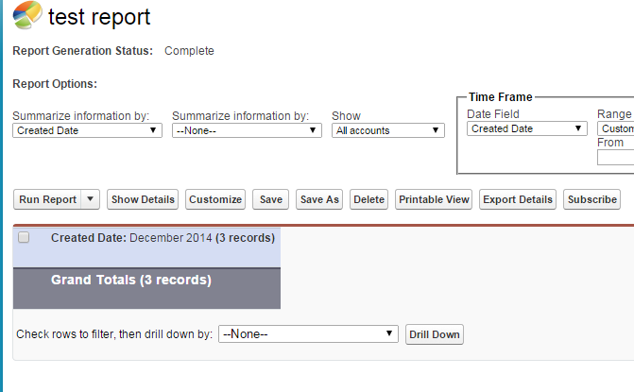
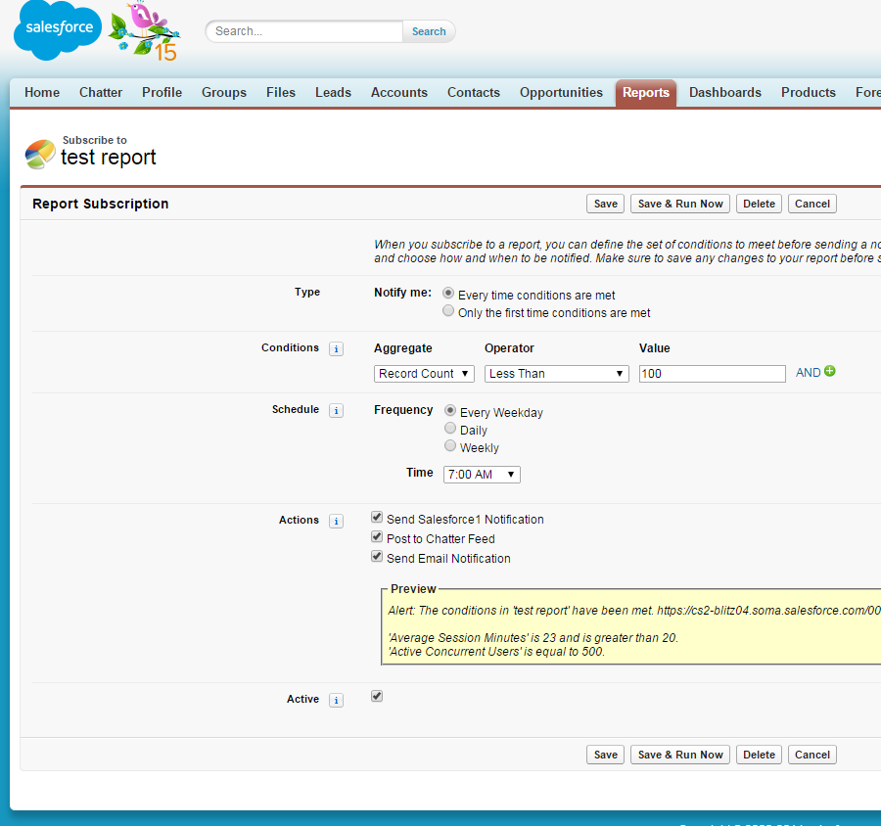
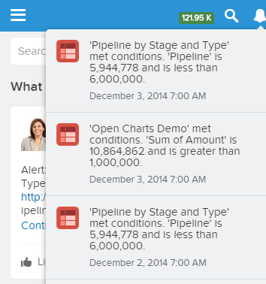
Key Capabilities – Report Notifications
Get alerts based on your threshold
Notified via Salesforce1, Email, or Chatter
Doesn’t count towards Scheduled Report Limits
Limit – 5 subscriptions per user

Slide 10
Key Capabilities – Report Notifications
Get alerts based on personal threshold
Notified via Salesforce1, Email, or Chatter
Doesn’t count towards Scheduled Report Limits
Limit – 5 subscriptions per user
Available on PE, DE, EE, UE and PxE
Live Demo

Slide 11
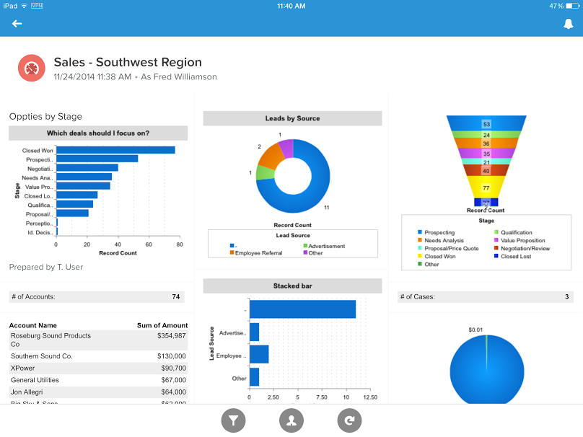
Key Capabilities: Tablet Optimization
Purpose: View up to three columns of dashboard in landscape and portrait mode on tablet.
Scroll up and down to see all components in each column

Slide 12
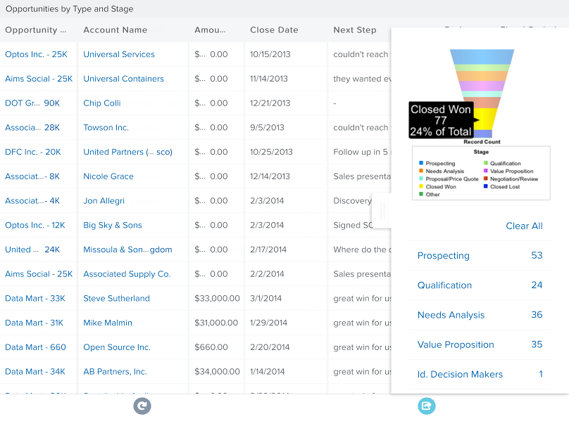
Key Capabilities: Tablet Optimization
Purpose: Interactively filter report by tapping on chart.
Interact with chart or legend on side panel. Select multiple filters from legend by tapping.

Slide 13
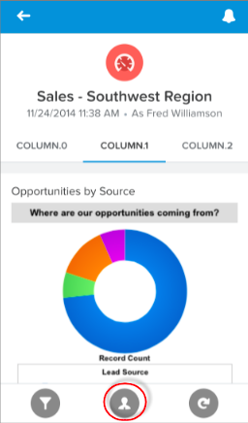
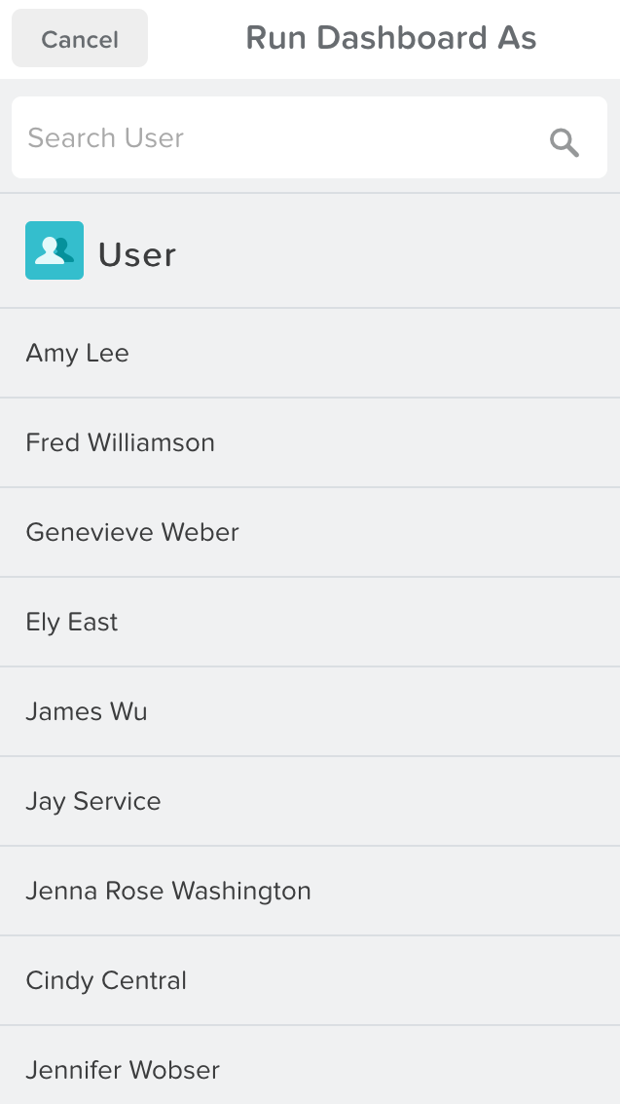
Key Capabilities: Dynamic Dashboards
Purpose: To run dashboard as someone else and view results.
Search for user to Run Dashboard As
Tap on User icon in action bar

Slide 14
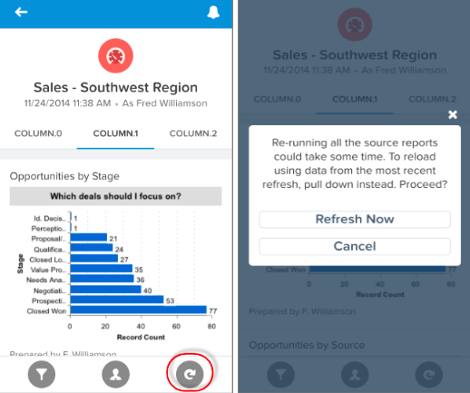
Key Capabilities: Refresh Dashboards More Easily
Purpose: Two options for refresh and rerun.
Live Demo
Make a decision on reloading latest refresh or re-running the source reports. Reloading by Pull to refresh will be faster.
Tap re-run icon in action bar

Slide 15
Chatter Enhancements

Slide 16
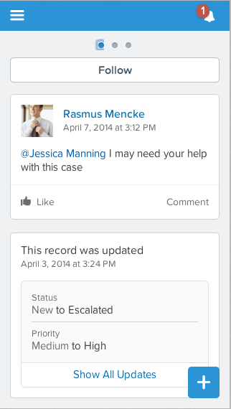
What are the Enhancements to Chatter? (cont.)
Bundled Posts available in Salesforce1 Web and Salesforce1 mobile:
When a series of changes to record data take place within a short window of time, those changes are bundled together as a summary post, thus making users’ posts more prominent.
Bundled Post:
One post representing a group of sequential changes to the record.

Slide 17
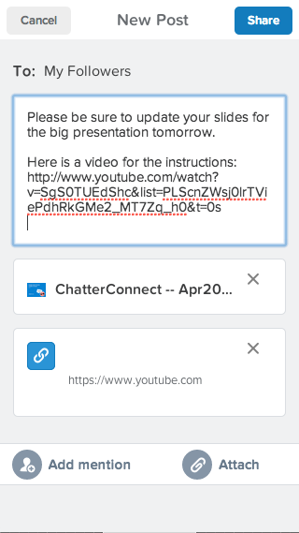
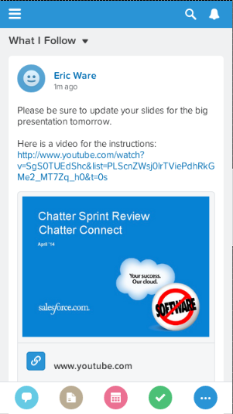
What are the Enhancements to Chatter? (cont.)
Consolidated Post Action available in Salesforce1 Web and Salesforce1 mobile:
Allows users to attach files and links to the same post in the Salesforce1 web application.
Attach Files and include Links.

Slide 18
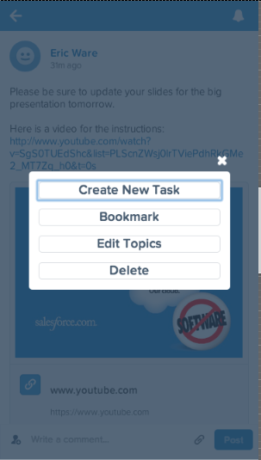
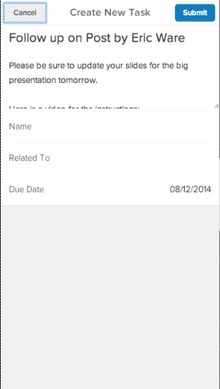
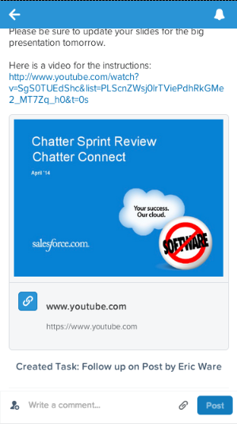
What are the Enhancements to Chatter? (cont.)
Feed Post Actions available in Salesforce1 Web and Salesforce1 mobile:
Use the “Create New Task” action from a post and follow the conversation and files from your task list.
Create New Task
available from Feed Post Menu.
Use the link on the post to navigate to the task that you created.

Slide 19
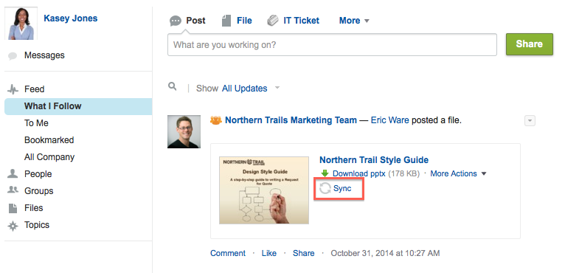
What are the Enhancements to Salesforce Files Sync?
Files Sync now supports:
Synchronizing files shared by others, directly from Chatter feed posts, file lists, and file detail pages. Previously, users could only sync their own files.
Users having up to 10,000 synced files.
Windows 8 and 8.1, and Mac OS X Yosemite.

Slide 20
What are the Enhancements to Salesforce Files Sync? (cont.)
Files Sync Managed Version provides Salesforce Admins with the ability to silently install Salesforce Files Sync to users’ desktops via MSI:
Deploy the Salesforce Files Sync client to your entire organization’s desktop machines.
Control who gets to install the desktop applications and when the client is upgraded.
.

Slide 21
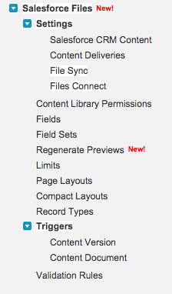
What are the Enhancements to Salesforce Files?
Administrators can now configure Files and Content in Setup under
Customize | Salesforce Files.
Files and Content Configuration
Members in Public Self-Service Communities can attach files to their Q&A posts.
Files and Communities

Slide 22
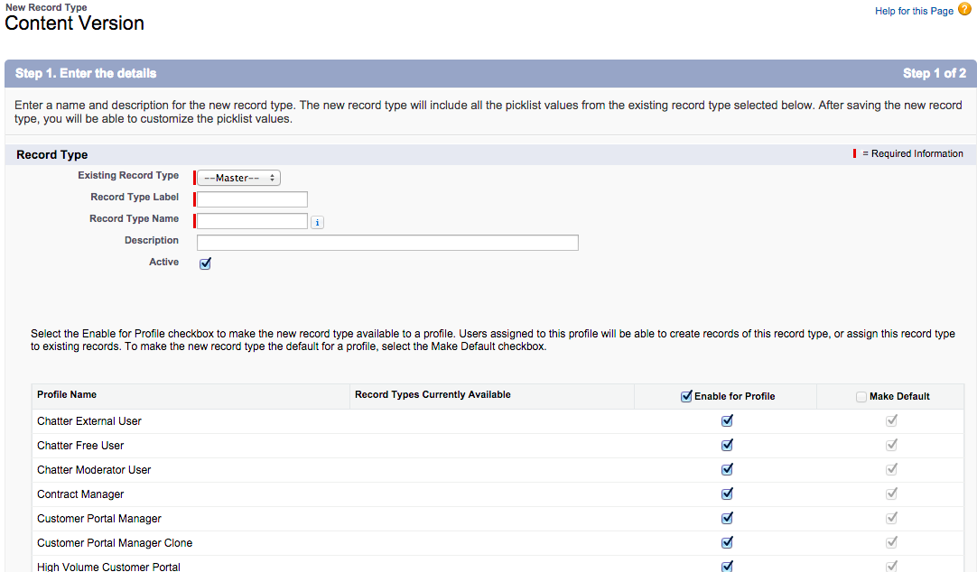
What are the Enhancements to Files Administration?
Salesforce Files now supports Record Types and Page Layouts.
Previously, most customizable objects supported Record Types and Page Layouts, but Files did not.
Administrators can now set both of these for Files and Content, using the Record Types and Page Layouts Setup pages in the new Salesforce Files node.
Unified Record Types and Page Layouts replace Content Types for Salesforce Files (Both Content and Chatter Files).

Slide 23
Dupe Management

Slide 24
It’s been a long time coming…

Slide 25
Feature Overview
Key Capabilities
Duplicate & Matching Rules: Administrators can configure matching rules for what constitutes a duplicate and duplicate rules for what Salesforce.com should do when a duplicate is found; these options include blocking, alerting and reporting.
Duplicate Alerts: End users will be alerted if they are creating a duplicate whether working in the traditional Salesforce desktop UI or in Salesforce1. Matching records are presented to the user so they can work with an existing record instead of creating a duplicate.

Slide 26
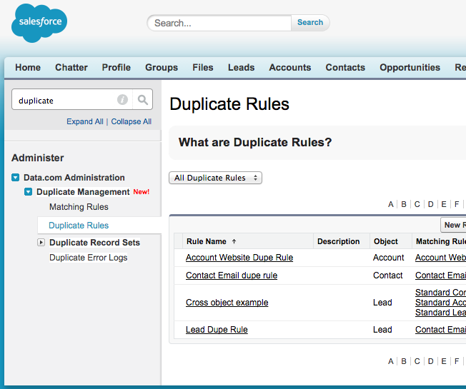
Duplicate Management in setup
Help Documentation for Duplicate Management:
https://help.salesforce.com/HTViewHelpDoc?id=duplicate_prevention_map_of_concepts.htm&language=en_US
‘Duplicate Rules’ appears in setup for everyone
Setup – Data.com Administration – Duplicate Management
NOTE: If using the Nonprofit Starter Pack, these don’t quite work…yet. Check the HUB for updates.

Slide 27
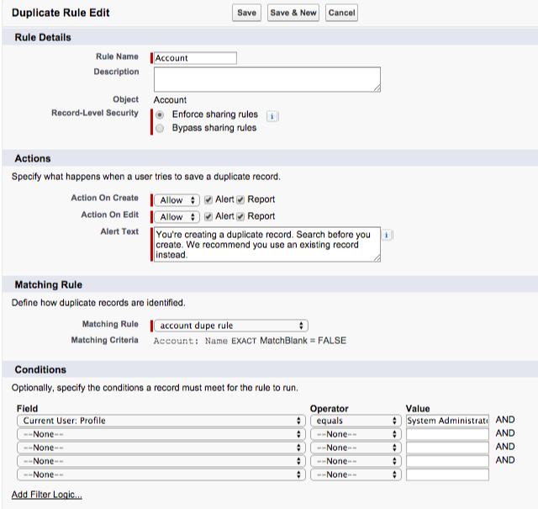
Dupe Rules
To control whether and when users can save duplicate records within Salesforce, create a duplicate rule and associate a matching rule to it.
Enforce or bypass sharing rules
Live Demo
Allow or Block options on create/edit. Report options
Customize Alert Text. Eg. You may want to have them global search before create
Which Matching rule
Eg. don’t run when Sys Admin or other profile, could alter for State, or Product
Add Filter Logic

Slide 28
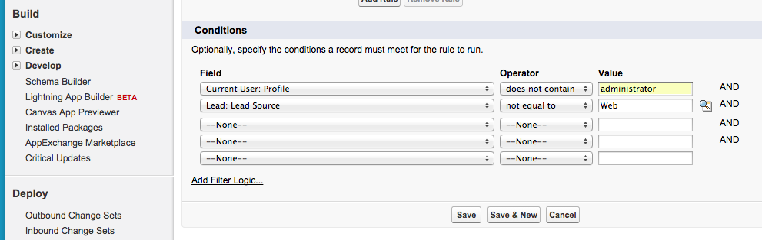
Conditional Criteria
Define conditional criteria to limit which records duplicate rules apply to
Criteria option available on duplicate rules
If an evaluated record doesn’t meet criteria, it ignores the rule
Conditions can be set on any fields on the current object type or user
Conditions also support advanced filter logic

Slide 29
Duplicate Rules – List View
Can prioritize order of rules

Slide 30
Matching Rules
Use matching rules to determine how two records are compared and identified as duplicates
Admins can configure custom match rules with exact or fuzzy match logic
Now also supports lookup fields and pick lists
Filter Logic

Slide 31
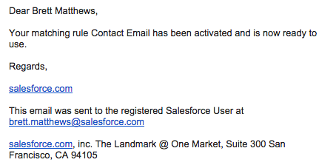
Matching Rules List View
Preconfigured matching rules have been included
Must Activate a Rule before using
Email confirmation sent once activation completed

Slide 32
What are the Enhancements to Duplicate Management? (cont.)
Support for custom objects

Slide 33
What are the Enhancements to Duplicate Management? (cont.)
Match rules support picklists

Slide 34
What are the Enhancements to Duplicate Management? (cont.)
Field mapping

Slide 35
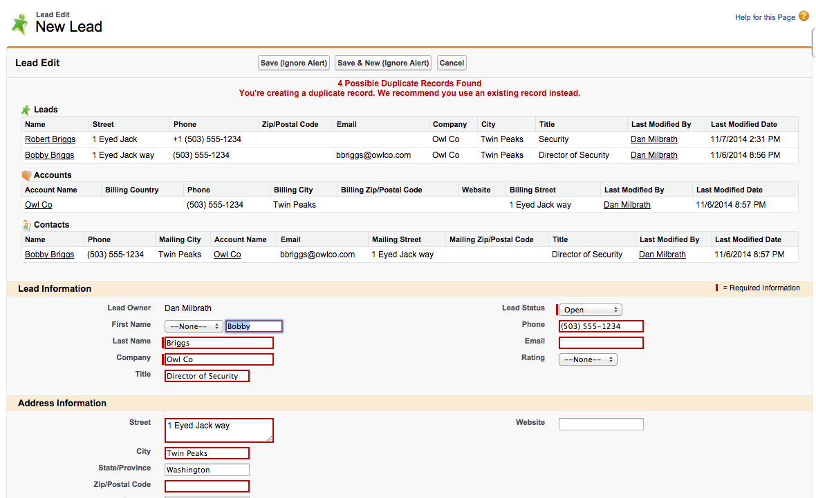
What are the Enhancements to Duplicate Management? (cont.)
Cross-object duplicate rules

Slide 36
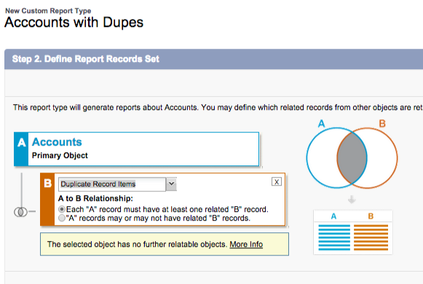
Reporting
Live Demo
Need to create a Custom Report Types for Dupes
Create Custom Report Types:
Accounts, Contacts, Leads, etc. to Dupe Record Items
Dupe Items All

Slide 37
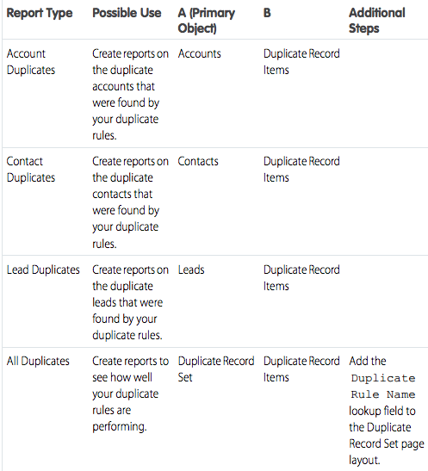
Reporting Cont’d
Custom Report Types

Slide 38
Lightning Process Builder

Slide 39
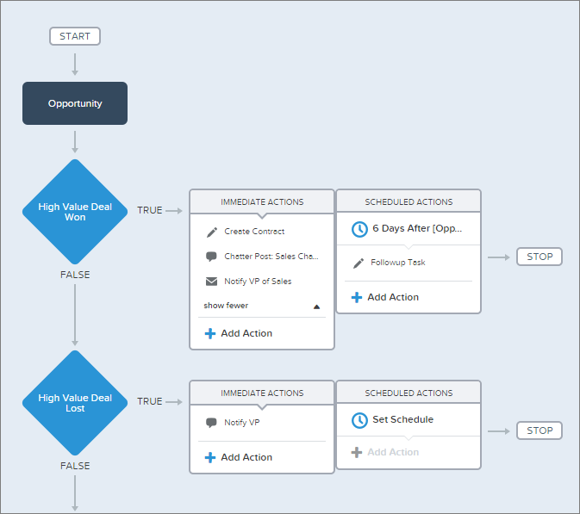
What is Lightning Process Builder?
Lightning Process Builder lets you automate business processes using a visual interface.
Processes allow you to execute action groups when certain conditions are met.
Action groups can consist of immediate and scheduled actions.
Capabilities include:
Creating a record.
Updating fields on records or any related record.
Launching a trigger-ready flow as an immediate or scheduled action.
Sending an email.
Posting to Chatter.
Submitting for approval.
Triggering Apex.
Prior to Process Builder, you had to use Visual Workflow or Apex to create a record, update fields on any related record, post to Chatter, or submit a record for approval.

Slide 40
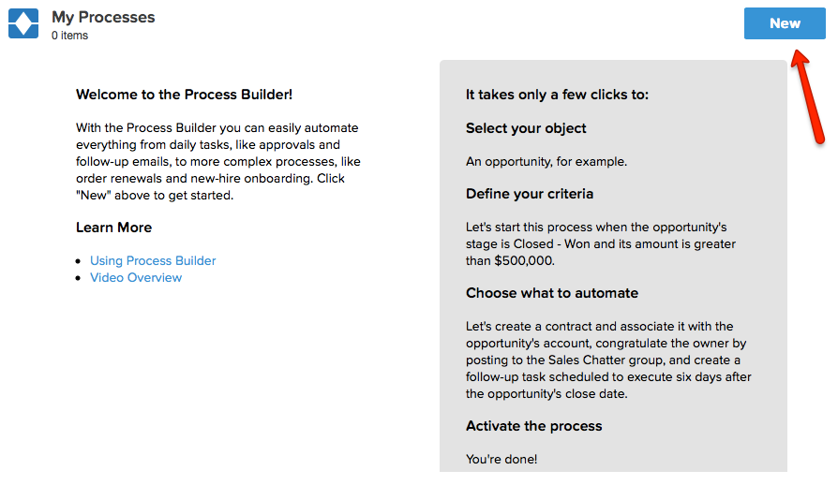
Setup – Create – Workflow & Approvals – Process Builder

Slide 41
Planning before you get to the Process Builder
WHICH Object (Account, Contact, Opportunity, etc) starts the process?
WHAT is the criteria for starting your process?
WHAT do you want to happen (see next slide)?
WHEN do you want it to happen (immediately or after time)?

Slide 42
What Actions are Supported by Lightning Process Builder?
Actions | Description
Create a record | Create a new record.
Update records | Update fields on records or any related records.
Send an email | Send an email using an email alert.
Post to Chatter | Post to the feed of a user, a Chatter group, or the record that started the process.
Use a quick action | Use an object-specific or global action to create a record, update a record, or log a call.
Submit for approval | Submit a record for approval without requiring users to submit manually.
Launch a flow | Launch a trigger-ready flow to automate complex business processes.
Call Apex | Call an Apex method to add customized functionality.
Prior to Process Builder, you had to use Visual Workflow or Apex to create a record, update fields on any related record, post to Chatter, or submit a record for approval.

Slide 43
Example Process
For big donations, I would like to post to our Advancement Group in Chatter and create a follow-up Thank You Call task.

Slide 44
Example Process
WHICH Object (Account, Contact, Opportunity, etc) starts the process?
Opportunity
WHAT is the criteria for starting your process?
Stage = Closed/Won AND Amount >= $10K
WHAT do you want to happen (see next slide)?
Post to Advancement Team Chatter Group
Create a follow up thank you call task for the Opp Owner
WHEN do you want it to happen (immediately or after time)?
Immediately

Slide 45
Example Process
Live Demo

Slide 46
Communities Enhancements

Slide 47
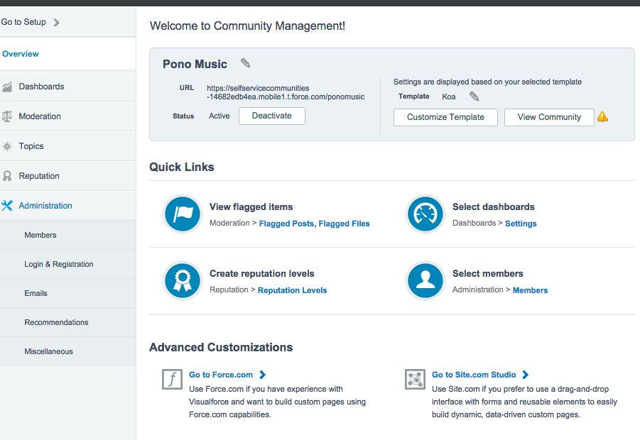
What is the new Setup & Community Management Console?
Community setup and management consolidated into the Community Console, where Community Managers can view, analyze, manage, and act on community information.
New features:
Setup overlay moved to console
Streamlined wizard-based flow
Intelligent navigation options
Enhanced overview page
New files moderation page
Topic Management (beta)
Custom Recommendations

Slide 48
What are the Enhancements to Community Builder?
Users creating a new community will be taken through an improved setup experience.
Add a new community to trigger the Starter Wizard.
Choose a template.

Slide 49
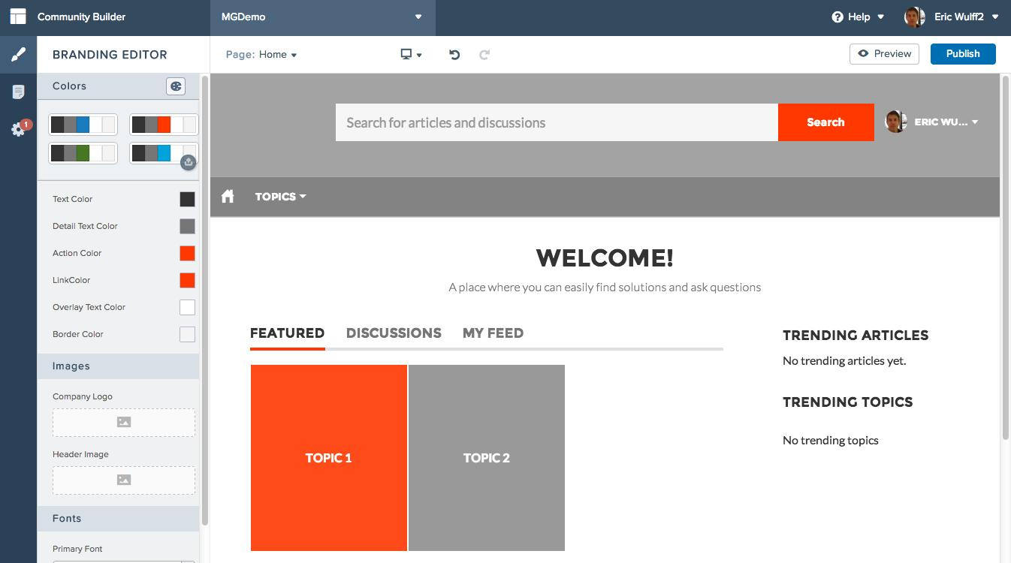
What are the Enhancements to Community Builder? (cont.)
Use the Branding Editor to customize the template.
Choose a palette to quickly change colors.
Update colors using the branding editor, then review live on the canvas.
Get branding done faster by uploading your company logo and automatically generating a color palette for your community.

Slide 50
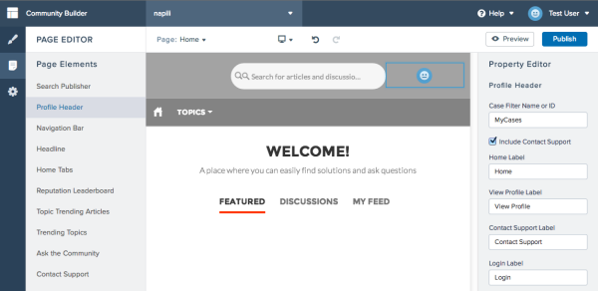
What are the Enhancements to Community Builder? (cont.)
Once your community setup is complete:
Use the new Page Editor and associated Property Editor to modify the various components on a page within a community to update text labels, pick the number of results to display, and more.

Slide 51
What are the Enhancements to Community Builder? (cont.)
Once your community setup is complete:
Use the new Settings area to get important info about the current template and links to add data.
Receive notifications about the availability of new templates.
Try out new templates for published communities by upgrading the current community to the new template and reverting to the previous one if the new template does not meet your needs.

Slide 52
Exchange and Outlook Enhancements

Slide 53
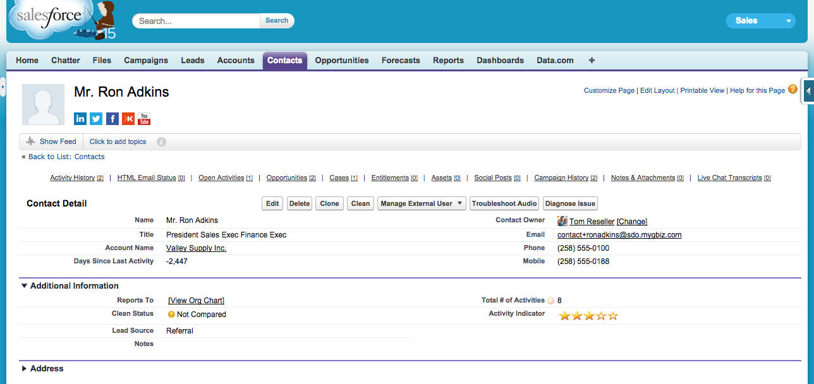
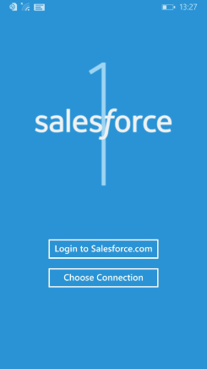
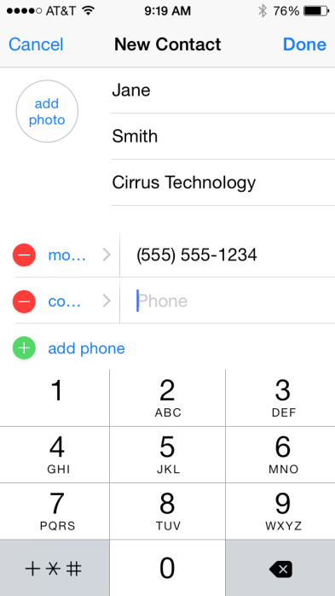
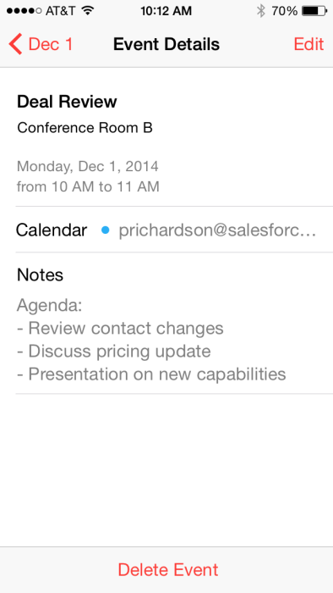
What are the Enhancements to Exchange Sync?
Keep the contacts and events in your users’ Exchange-based email systems in sync with contacts and events in Salesforce, without requiring your users to install and maintain software on their workstations.

Slide 54
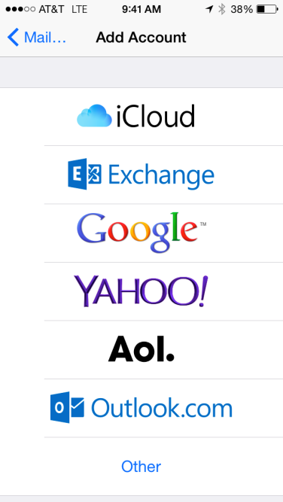
What are the Enhancements to Exchange Sync? (cont.)
How it works: Server-to-Server

Slide 55
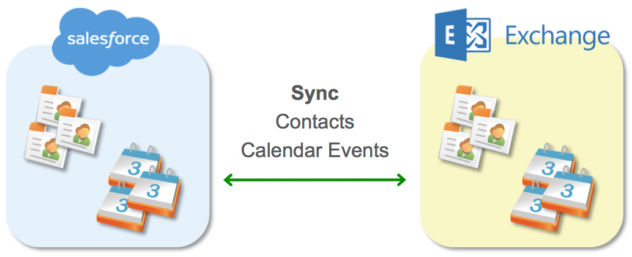
What are the Enhancements to Exchange Sync? (cont.)
Feature overview: Server-based sync engine benefits
Server-to-Server sync — runs in the background, always working
Any device — Windows, Mac, iOS, Android
Easy on IT — nothing to install, central management

Slide 56
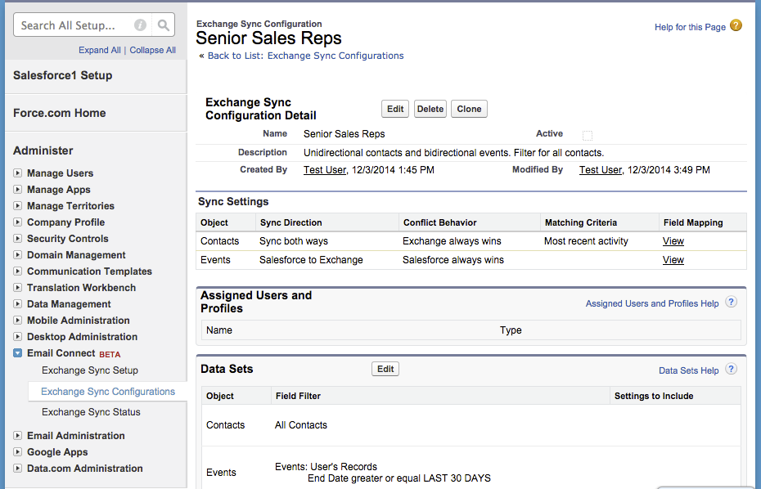
What are the Enhancements to Exchange Sync? (cont.)
Exchange Sync Configurations:
Set up sync directions, behaviors, and filters for different user populations.

Slide 57
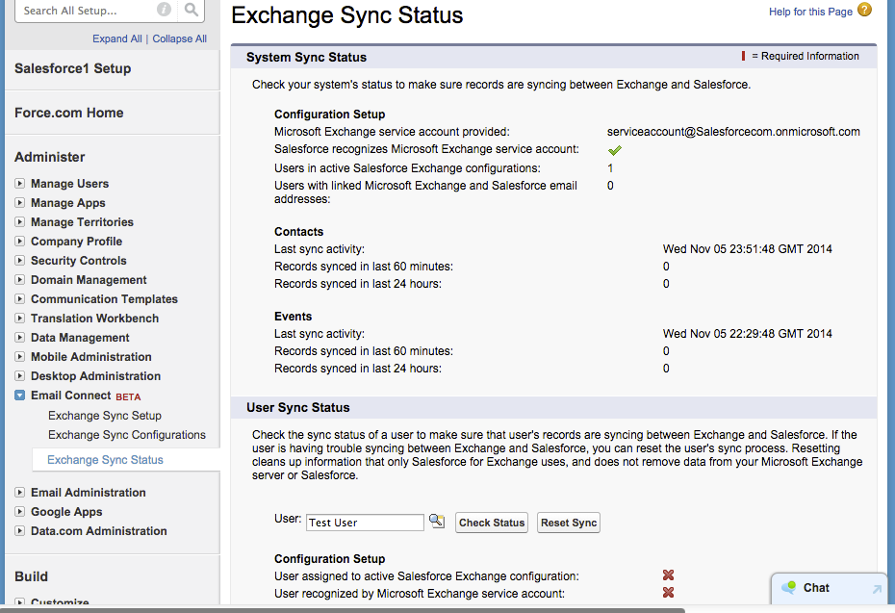
What are the Enhancements to Exchange Sync? (cont.)
Exchange Sync Status Admin Setup allows overview of org-wide and user-specific sync status.

Slide 58
Sample Use Cases
Sales Manager wants a record in Salesforce of Sales Reps’ customer meetings (events)
Meeting Scheduler wants to set up events in Salesforce and have them appear in Sales Reps’ Outlook
Sales Rep needs customer contact info available outside of Salesforce
IT Professional needs to enable a sync technology for a diverse set of devices and OSs
Notes:
A Sales Rep wants to use Outlook to manage her meeting invites, etc., but wants to keep a record of his meetings in Salesforce. With the Event sync feature, the Sales Rep knows that her Salesforce calendar will have a record of the meetings from Outlook.
A Sales Rep wants to make a phone call to a contact that he knows exists in Salesforce. Instead of logging into Salesforce, he can just find the phone number in his phone’s contacts.
An IT Pro wants to enable syncing for a workforce with many OS’s and devices, but doesn’t want the headache of troubleshooting so many environments. Exchange Sync has no dependence on the user’s specific environment.

Slide 59
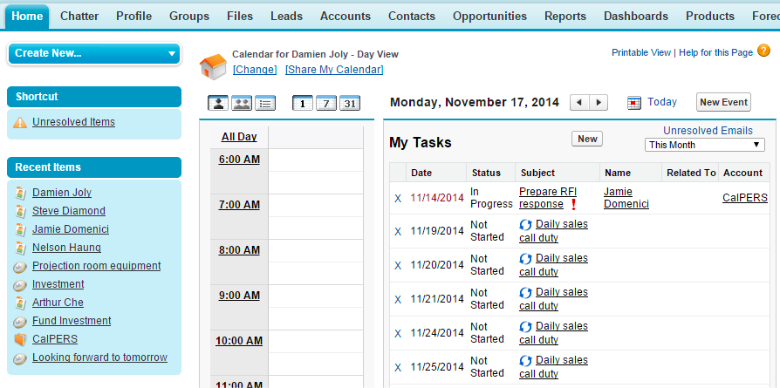
What are the Enhancements to Salesforce for Outlook? (cont.)
Sync recurring Salesforce tasks to Outlook.
Here’s a daily recurring task series in the Salesforce list view showing tasks due this month.

Slide 60
What are the Enhancements to Salesforce for Outlook? (cont.)
Sync recurring Salesforce tasks to Outlook.
Here’s the same recurring task in Outlook, in the view showing tasks due today and tomorrow.
We don’t support adding Outlook recurring tasks to Salesforce records.

Slide 61
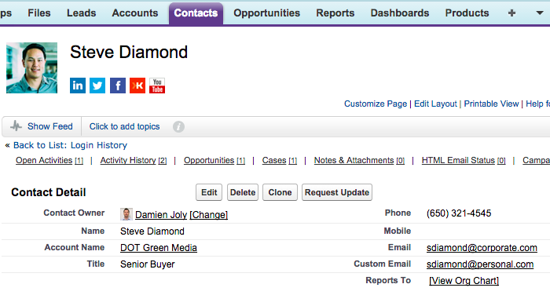
What are the Enhancements to Salesforce for Outlook? (cont.)
Find more contacts and leads in the side panel.
Here are the email addresses for Steve. The side panel displays contact details regardless of whether the contact sends an email from their corporate or personal email address.

Slide 62
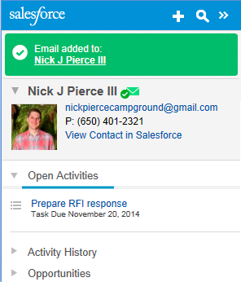
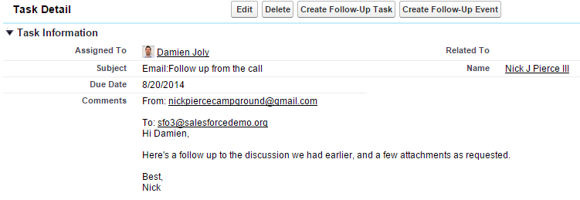
What are the enhancements to Salesforce for Outlook? (cont.)
Add emails to person accounts.
According to settings in the Outlook configuration, adding an Outlook email to a Person Account is done as either:
An account, appearing in the Salesforce task’s Related To field.
A contact, appearing in the Salesforce task’s Name field.
The task fields for Related To and Name.

Slide 63
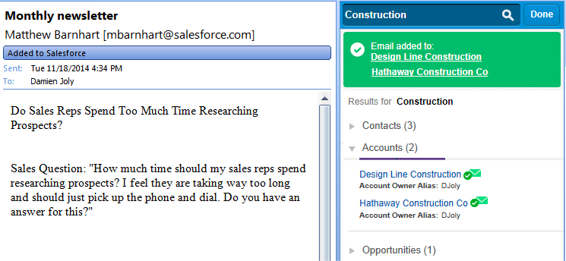
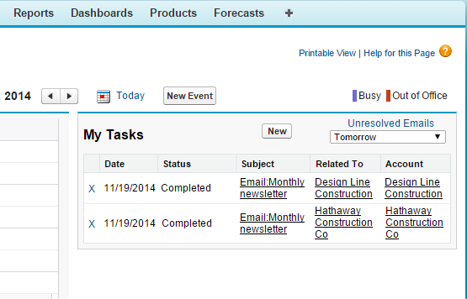
What are the Enhancements to Salesforce for Outlook? (cont.)
Add emails to multiple Salesforce records that accept tasks (besides contacts).
Add an Outlook email to multiple accounts using the side panel.
We create one task for each association in Salesforce.

Slide 64
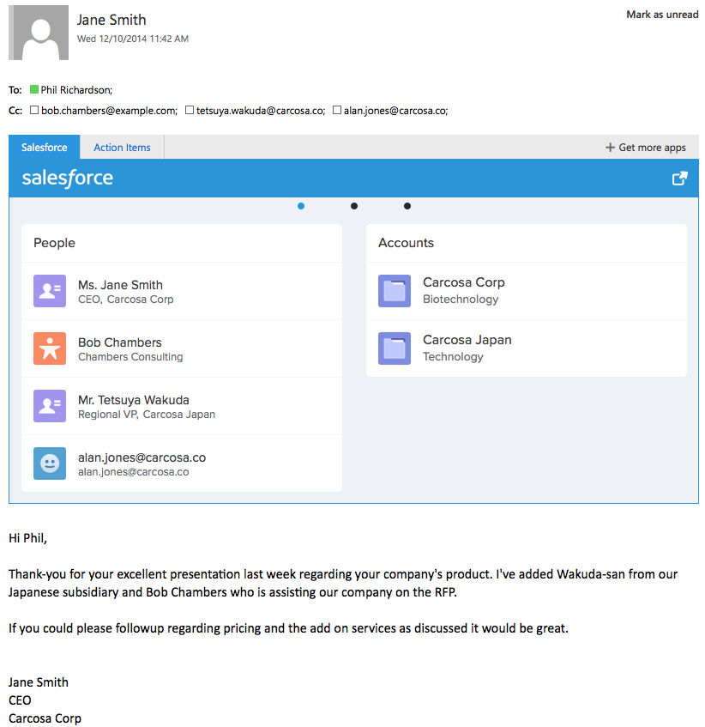
Key Capabilities
What are the Enhancements to Salesforce for Outlook? (cont.)
See records about contacts included in the email, such as Accounts, Opportunities, Cases
Automatically displays Salesforce records related to an email including:
People i.e. Salesforce Users, Contacts, and Leads
Accounts
Opportunities
Cases
One-click launch from an email
Create new contact when not already found in Salesforce

Slide 65
Resources for You
Salesforce Foundation Power of Us HUB http://powerofus.force.com
Salesforce Foundation Website: www.salesforcefoundation.org/help
Spring ‘15 Release Notes:www.salesforce.com/customer-resources/releases/spring15/
Release Notes Spotlight: http://releasenotes.docs.salesforce.com/en-us/spring15/release-notes/salesforce_release_notes.htm
Spring 15 Release Notes: Dupe Managementhttp://releasenotes.docs.salesforce.com/spring15/spring15/release-notes/rn_sales_duplicate_management_intro.htm
Lightning Process Builder https://help.salesforce.com/HTViewHelpDoc?id=process_overview.htm&language=en_US

